Slide 1

Lecture #9

Slide 2
Operating system by Saima Kanwal
Lecture # 10

Slide 3
Process Concept
Process is a program in execution.
A process is more than the program code, which is sometimes known as the text section.
It also includes the current activity, as represented by the value of the program counter and the contents of the processor’s registers.
A process generally also includes the process stack, which contains temporary data (such as function parameters, return addresses, and local variables), and a data section, which contains global variables.
Program by itself is not a process.
A program is a passive entity, such as a file containing a list of instructions stored on disk.
Process is an active entity, with a program counter specifying the next instruction to execute and a set of associated resources.

Slide 4
Example
Although two processes may be associated with the same program, they are nevertheless considered two separate execution sequences.
For instance, several users may be running different copies of the mail program, or the same user may invoke many copies of the web browser program.
Each of these is a separate process

Slide 5
Process State
As a process executes, it changes state. The state of a process is defined in part by the current activity of that process. A process may be in one of the following states:
New The process is being created.
Ready The process is waiting to be assigned to a processor.
Running Instructions are being executed.
Waiting The process is waiting for some event to occur (such as an I/O completion or reception of a signal).
Terminated The process has finished execution.
It is important to realize that only one process can be running on any processor at any instant. Many processes may be ready and waiting, however.

Slide 6
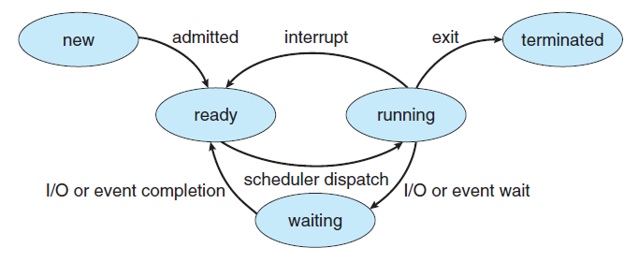

Slide 7
Process Control Block
Each process is represented in the operating system by a process control block (PCB)—also called a task control block.
It contains many pieces of information associated with a specific process, including these:
Process state
Program counter
CPU registers
CPU-scheduling information
Memory-management information
Accounting information.
I/O status information

Slide 8
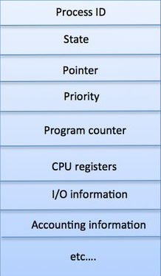
Cont.
Process state: The state may be new, ready, running, waiting, halted, and so on.
Program counter: The counter indicates the address of the next instruction to be executed for this process.
CPU registers. The registers vary in number and type, depending on the computer architecture. They include accumulators, index registers, stack pointers, and general-purpose registers, plus any condition-code information. Along with the program counter, this state information must be saved when an interrupt occurs, to allow the process to be continued correctly afterward

Slide 9
Cont.
CPU-scheduling Information.
This information includes a process priority, pointers to scheduling queues, and any other scheduling parameters.
Memory-management Information.
This information may include such items as the value of the base and limit registers and the page tables, or the segment tables, depending on the memory system used by the operating system.
Accounting information
This information includes the amount of CPU and real time used, time limits, account numbers, job or process numbers, and so on
I/O status information.
This information includes the list of I/O devices allocated to the process, a list of open files, and so on.

Slide 10
Threads
A thread is the smallest unit of processing that can be performed in an OS.
In most modern operating systems, a thread exists within a process - that is, a single process may contain multiple threads.
A thread is also called a lightweight process.
Threads provide a way to improve application performance through parallelism.

Slide 11
Process Scheduling
The objective of multiprogramming is to have some process running at all times, to maximize CPU utilization.
The objective of time sharing is to switch the CPU among processes so frequently that users can interact with each program while it is running.
To meet these objectives, the process scheduler selects an available process (possibly from a set of several available processes) for program execution on the CPU.
For a single-processor system, there will never be more than one running process.
If there are more processes, the rest will have to wait until the CPU is free and can be rescheduled.

Slide 12
Scheduling Queues
As processes enter the system, they are put into a job queue, which consists of all processes in the system.
The processes that are residing in main memory and are ready and waiting to execute are kept on a list called the ready queue.
This queue is generally stored as a linked list.
Each PCB includes a pointer field that points to the next PCB in the ready queue.

Slide 13
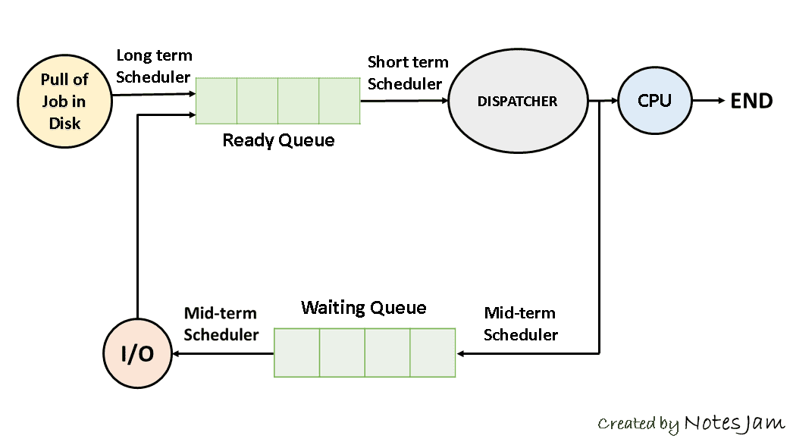

Slide 14
Cont.
When a process is allocated the CPU, it executes for a while and eventually quits, is interrupted, or waits for the occurrence of a particular event, such as the completion of an I/O request.
Suppose the process makes an I/O request to a shared device, such as a disk.
Since there are many processes in the system, the disk may be busy with the I/O request of some other process.
The process therefore may have to wait for the disk.
The list of processes waiting for a particular I/O device is called a device queue.
Each device has its own device queue

Slide 15
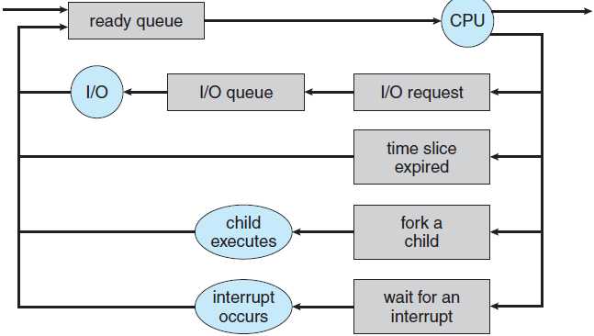
A common representation of process scheduling is a queueing diagram.
Each rectangular box represents a queue.
Two types of queues are present: the ready queue and a set of device queues.
The circles represent the resources that serve the queues, and the arrows indicate the flow of processes in the system.
A new process is initially put in the ready queue.
It waits there until it is selected for execution, or dispatched.

Slide 16
Cont.
Once the process is allocated the CPU and is executing one of several events could occur:
The process could issue an I/O request and then be placed in an I/O queue.
The process could create a new child process and wait for the child’s termination.
The process could be removed forcibly from the CPU, as a result of an interrupt, and be put back in the ready queue.

Slide 17
Schedulers
A process migrates among the various scheduling queues throughout its lifetime.
The operating system must select, for scheduling purposes, processes from these queues in some fashion.
The selection process is carried out by the appropriate scheduler.
Often, in a batch system, more processes are submitted than can be executed immediately.
These processes are spooled to a mass-storage device (typically a disk), where they are kept for later execution.
The long-term scheduler, or job scheduler, selects processes from this pool and loads them into memory for execution.

Slide 18
short-term scheduler
The short-term scheduler, or CPU scheduler, selects from among the processes that are ready to execute and allocates the CPU to one of them.
The short-term scheduler must select a new process for the CPU frequently.
A process may execute for only a few milliseconds before waiting for an I/O request.

Slide 19
long-term scheduler
It is also called a job scheduler.
A long-term scheduler determines which programs are admitted to the system for processing.
It selects processes from the queue and loads them into memory for execution.
Process loads into the memory for CPU scheduling.
The primary objective of the job scheduler is to provide a balanced mix of jobs, such as I/O bound and processor bound.
It also controls the degree of multiprogramming. If the degree of multiprogramming is stable, then the average rate of process creation must be equal to the average departure rate of processes leaving the system.

Slide 20
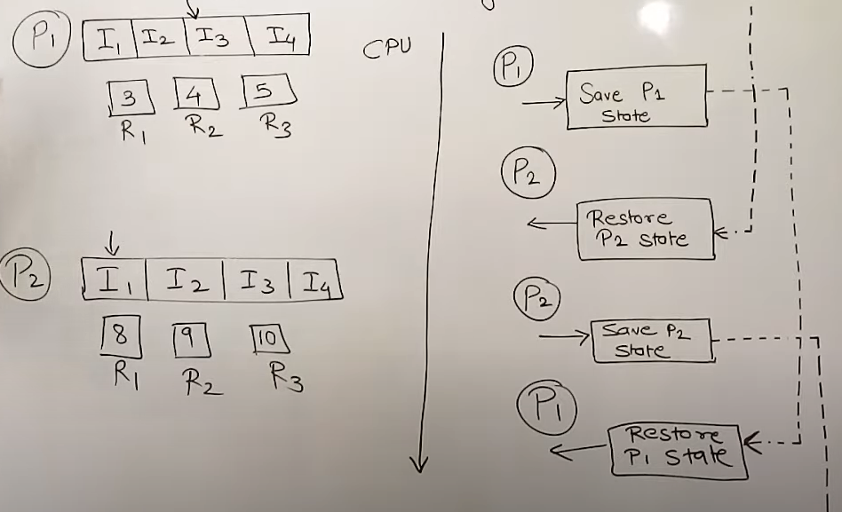
Context Switch

Slide 21
Context Switch
When an interrupt occurs, the system needs to save the current context of the process running on the CPU so that it can restore that context when its processing is done, essentially suspending the process and then resuming it.
The context is represented in the PCB of the process. It includes the value of the CPU registers, the process state, and memory-management information.
Generically, we perform a state save of the current state of the CPU, be it in kernel or user mode, and then a state restore to resume operations.
Switching the CPU to another process requires performing a state save of the current process and a state restore of a different process.
This task is known as a context switch.

Slide 22
Cont.
When a context switch occurs, the kernel saves the context of the old process in its PCB and loads the saved context of the new process scheduled to run.
Context-switch time is pure overhead, because the system does no useful work while switching.
Switching speed varies from machine to machine, depending on the memory speed, the number of registers that must be copied, and the existence of special instructions (such as a single instruction.
A typical speed is a few milliseconds.

Slide 23
Homework
Degree of multiprogramming
I/O-bound process
CPU-bound process
MULTITASKING IN MOBILE SYSTEMS

Slide 24
Operations on Processes
The processes in most systems can execute concurrently, and they may be created and deleted dynamically.
Thus, these systems must provide a mechanism for process creation and termination

Slide 25
Process Creation
During the course of execution, a process may create several new processes.
As mentioned earlier, the creating process is called a parent process, and the new processes are called the children of that process.
Each of these new processes may in turn create other processes, forming a tree of processes.
A child process can have only one parent but a parent process may have many children.
Due to the name of the fork function, the act of creating a new process is sometimes called forking a process.
Each new process (the child process or subprocess) is allocated a process ID, distinct from the process ID of the parent process.

Slide 26
Cont.
In general, when a process creates a child process, that child process will need certain resources (CPU time, memory, files, I/O devices) to accomplish its task.
The parent may have to partition its resources among its children, or it may be able to share some resources (such as memory or files) among several of its children.

Slide 27
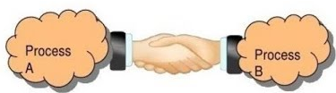
Interprocess Communication
Any process that does not share data with any other process is independent.
A process is cooperating if it can affect or be affected by the other processes executing in the system.
Clearly, any process that shares data with other processes is a cooperating process.
There are several reasons for providing an environment that allows process cooperation:
Information sharing
Computation speedup
Modularity
Convenience

Slide 28
Cont.
Information sharing Since several users may be interested in the same piece of information (for instance, a shared file), we must provide an environment to allow concurrent access to such information.
Computation speedup If we want a particular task to run faster, we must break it into subtasks, each of which will be executing in parallel with the others. Notice that such a speedup can be achieved only if the computer has multiple processing cores.
Modularity We may want to construct the system in a modular fashion, dividing the system functions into separate processes or threads.
Convenience Even an individual user may work on many tasks at the same time. For instance, a user may be editing, listening to music, and compiling in parallel.

Slide 29
Cont.
Cooperating processes require an interprocess communication (IPC) mechanism that will allow them to exchange data and information.
There are two fundamental models of interprocess communication:
Shared Memory
Message Passing
In the shared-memory model, a region of memory that is shared by cooperating processes is established.
Processes can then exchange information by reading and writing data to the shared region.
In the message-passing model, communication takes place by means of messages exchanged between the cooperating processes.

Slide 30
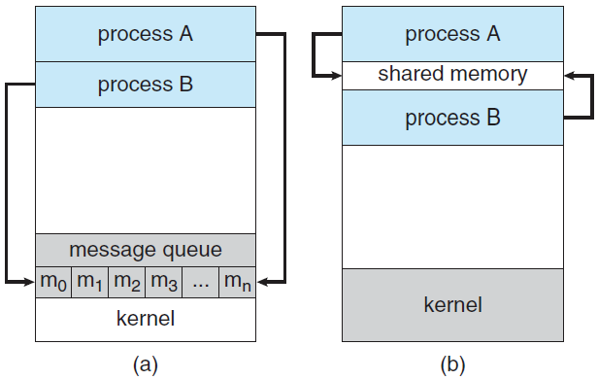
Messaging passing vs shared memory

Slide 31
Cont.
Both of the models just mentioned are common in operating systems, and many systems implement both.
Message passing is useful for exchanging smaller amounts of data, because no conflicts need be avoided.
Message passing is also easier to implement in a distributed system than shared memory.
Shared memory can be faster than message passing, since message-passing systems are typically implemented using system calls and thus require the more time-consuming task of kernel intervention.
In shared-memory systems, system calls are required only to establish shared memory regions.
Once shared memory is established, all accesses are treated as routine memory accesses, and no assistance from the kernel is required.

Slide 32
Shared-Memory Systems
Typically, a shared-memory region resides in the address space of the process creating the shared-memory segment.
Other processes that wish to communicate using this shared-memory segment must attach it to their address space.
Recall that, normally, the operating system tries to prevent one process from accessing another process’s memory.
Shared memory requires that two or more processes agree to remove this restriction.
They can then exchange information by reading and writing data in the shared areas.
The form of the data and the location are determined by these processes and are not under the operating system’s control.
The processes are also responsible for ensuring that they are not writing to the same location simultaneously.

Slide 33
To illustrate the concept of cooperating processes, let’s consider the producer–consumer problem, which is a common paradigm for cooperating processes.
A producer process produces information that is consumed by a consumer process.
For example, a compiler may produce assembly code that is consumed by an assembler.
The assembler, in turn, may produce object modules that are consumed by the loader.
The producer–consumer problem also provides a useful metaphor for the client–server paradigm.
We generally think of a server as a producer and a client as a consumer. For example, a web server produces (that is, provides) HTML files and images, which are consumed (that is, read) by the client web browser requesting the resource.

Slide 34
One solution to the producer–consumer problem uses shared memory.
To allow producer and consumer processes to run concurrently, we must have available a buffer of items that can be filled by the producer and emptied by the consumer.
The producer and consumer must be synchronized, so that the consumer does not try to consume an item that has not yet been produced.
Two types of buffers can be used.
The unbounded buffer places no practical limit on the size of the buffer.
The consumer may have to wait for new items, but the producer can always produce new items.
The bounded buffer assumes a fixed buffer size.
In this case, the consumer must wait if the buffer is empty, and the producer must wait if the buffer is full.

Slide 35
Message-Passing Systems
The scheme requires that these processes share a region of memory and that the code for accessing and manipulating the shared memory be written explicitly by the application programmer.
Another way to achieve the same effect is for the operating system to provide the means for cooperating processes to communicate with each other via a message-passing facility.
Message passing provides a mechanism to allow processes to communicate and to synchronize their actions without sharing the same address space.
It is particularly useful in a distributed environment, where the communicating processes may reside on different computers connected by a network.
For example, an Internet chat program could be designed so that chat participants communicate with one another by exchanging messages.

Slide 36
A message-passing facility provides at least two operations:
send(message) receive(message)
Messages sent by a process can be either fixed or variable in size.
If only fixed-sized messages can be sent, the system-level implementation is straightforward. This restriction, however, makes the task of programming more difficult.
Conversely, variable-sized messages require a more complex system level implementation, but the programming task becomes simpler. This is a common kind of tradeoff seen throughout operating-system design.

Slide 37
Questions?

